Slide 1
BANK CUSTOMER CHURN PREDICTION
Naan Mudhalvan (NM) Project
NM Course: Generative AI
Presented by:
Sandhiya S
2021503552
Department of Computer Technology, MIT

Slide 2
OUTLINE
Problem Statement
Proposed Solution
System Development Approach
Algorithm and Deployment
Result
References

Slide 3
Problem Statement
Customer churn, the loss of a customer to a competitor, can be costly for banks.
To address this challenge, a neural network (NN) model is proposed that can predict which bank customers are at high risk of churning.

Slide 4
Proposed Solution
A multi-layered artificial neural network is proposed for classifying bank customer churn risk by determining whether the customers will leave or not in the next 6 months.
A grid search approach is used to optimize hyperparameters.

Slide 5
Proposed Solution
A sequential ANN is built using Keras.
Hyperparameter tuning is performed using a GridSearchCV object that explores different combinations of hyperparameters.
GridSearchCV picks the one that performs best on the training data using cross-validation.
The grid search identifies the combination of hyperparameters that yields the highest accuracy score.
This optimal model is then used for future predictions on unseen data.

Slide 6
System Development Approach
Hardware:
Moderate CPU (e.g., recent Intel Core i5 or AMD Ryzen 5)
Software:
Python 3.x
Keras
Google Colab
Libraries: NumPy, Pandas, Matplotlib, Seaborn

Slide 7
Algorithm and Deployment
Data Collection:
Downloaded the publicly available dataset from Kaggle. (https://colab.research.google.com/corgiredirector?site=https%3A%2F%2Fwww.kaggle.com%2Fbarelydedicated%2Fbank-customer-churn-modeling)
Import libraries (pandas, scikit-learn)
Read data from CSV file.
Encode categorical variables (e.g., one-hot encoding).
Analyze target variable distribution (churn vs. non-churn)
Model Architecture:
Artificial Neural Network (ANN) with sequential layers.
Input layer: Matches number of features (likely 14 from this dataset).
Hidden layers: 2-layer with ReLU activation (e.g., 5 neurons each).
Output layer: Single neuron with sigmoid activation (predicts churn probability).

Slide 8
Algorithm and Deployment
Hyperparameter Tuning:
Use GridSearchCV to explore a range of hyperparameter values.
Training and Evaluation:
GridSearchCV trains models with various hyperparameter combinations.
Cross-validation ensures model generalizability.

Slide 9
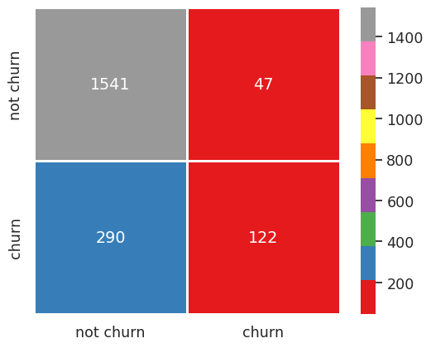
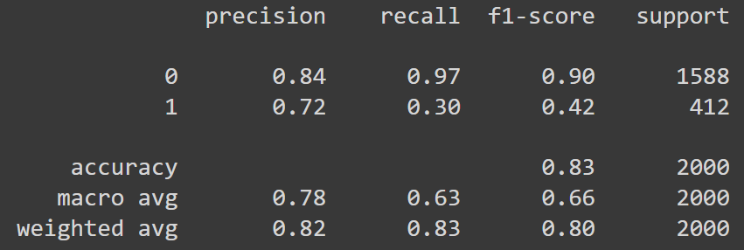
Result

Slide 10
References
https://keras.io/api/
https://keras.io/examples/
https://pandas.pydata.org/docs/

Slide 11
THANK YOU.

